Slide 1
Auto Sales Dashboard Summary
Task-4: Dashboard Design
Nikhil H R

Slide 2
Auto Sales Summary Dashboard
Objective: o provide insights into auto sales by product line, country, deal size, and over time using interactive Power BI visuals.
Metric | Value
Total Customers | 2,747
Total Quantity Ordered | 96K
Total Sales | 9.76M

Slide 3
Visual Highlights & Interactivity
Visual Highlights:
🔥 Sales by Product Line: Classic Cars dominate overall sales (~40%).
🧩 Deal Size Breakdown: Large deals make up ~61% of total sales.
🌍 Top Countries by Quantity: USA, Spain, and France lead.
📈 Sales Over Time: Noticeable peaks in late 2018 and late 2019.
Interactive Filters:
Deal Size: Large, Medium, Small
Product Types: Classic Cars, Motorcycles, Planes, etc.
Benefits:
Uncovers market demand by product line and geography
Supports business strategy with sales timing and deal size patterns

Slide 4
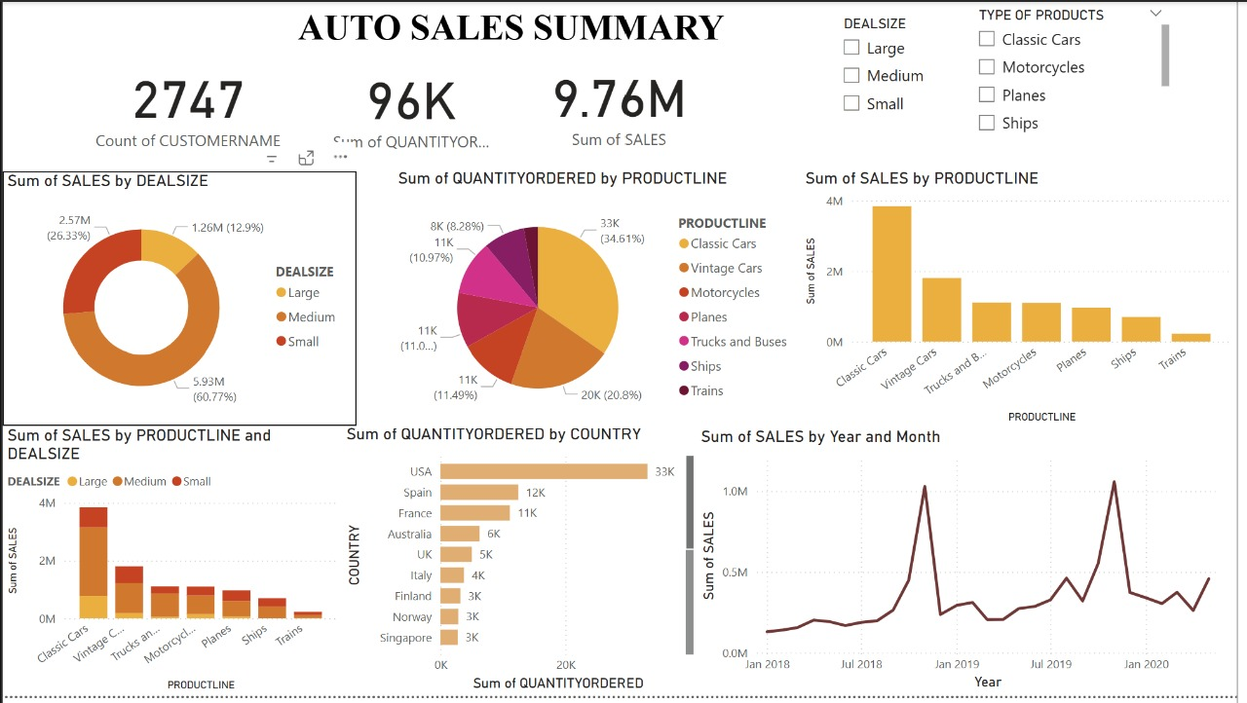

Slide 5
Thank you..

